Slide 1
Design/Practical Experience [CSN1020]
(Department of Computer Science & Engineering)
Project Title: Android Play Store Data Analysis
Presentation

Slide 2
Design/Practical Experience [CSN1020]
(Department of Computer Science & Engineering)
Mentor Name: Dr Sumit Kalra
Name: Dev Goel
Academic Year: 2021-22
Semester: 2

Slide 3

Overview
There are many reasons for the occurrence of Software Bugs. The most common reason is human mistakes in software design and coding.
Once you get to know the causes for Software Defects, then it will be easier for you to take corrective actions to minimize these defects.

Slide 4
Objective
The aim of this project is to analyze the kind of bugs that occurs in different categories of mobile apps. Some of the different types of bugs that occur in apps are compatibility crash bugs, performance issues, UI and UX bugs, network-related issues, memory leakage, slow responses, permission issues (camera, video, audio), general functionality issues, and module features, OS version issues etc. Hence, the objective is to analyse the different kinds of bugs occurring in different categories of apps like Social media, Educational, Utility, Gaming, Finance/Banking apps using data collected from web scraping different websites that contain this data about the version histories and bug histories of mobile apps to aid new developers. This will assist the developers to develop state-of-the-art apps that the public deserves.

Slide 5
Study/Research
The project's prerequisite involves the knowledge of writing web crawlers to scrape the data from the websites and the knowledge of metadata. So, I first learned about the metadata which is the index that gives the clue that where the data is stored to the user. It has three types i.e., operational, extraction and transformation, and end-uses. Operational gives a source of data from where it is extracted, extraction and transformation keep information of all the extracted data from the different data warehouse and their transformation and end-use is the index (overall view for metadata) tells the user how to access data/information.

Slide 6

Study/Research
Then, I also learned how to write the web crawlers in python to scrape the data from the websites for my project. I learned the Beautiful Soup which is a Python package for parsing HTML and XML documents. I read the documentation and watched the tutorials for this package. It basically builds a parse tree for the parsed pages, which may be used to extract data from HTML and hence it is useful for web scraping.

Slide 7



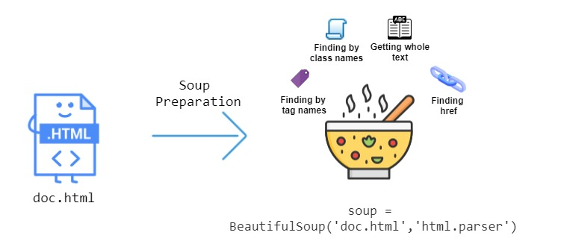
Technologies Used:
Google Colab
Python
Beautiful Soup
NumPy
Matplotlib
Pandas
Scikit-learn

Slide 8

Methodology adapted for Implementation
The methodology that I used for implementing the given project is that I first gathered the list of websites present on the internet that contains the version histories data, the date of update, and the updates on bug fixes. I gathered all the websites that contain the data for different categories of apps. Then, I applied the concepts of web scraping and scraped the data of at least 5 apps from each of the categories of apps chosen. For this part, I have to modify the scripts for some websites and also for scraping the websites I read about the different tags of HTML.

Slide 9
Methodology adapted for Implementation
Then, after scraping the data from different websites I stored them in a list and then created a dataframe using the pandas library. I created three columns the first one contains the name of the version of the apps, the second one contains the date of release and the last one contains the bug fixes comments. Then, with the help of some libraries of python, I analyzed the bug comments count and frequent bugs that appeared in each category of the app.

Slide 10

Issues Faced
<Response [503]> Error: While web scraping the websites, some of the websites returned this error. And for these websites, I was not able to scrape the data. So, I read about this error that a <Response [503]> status code normally means "Service unavailable". Hence, I was not able to scrape the information from these websites.
Extracting/Scraping data from websites: While scraping the data from the websites I was not able to access some of the text that was in between two different tags. So, I read about this in the documentation and fixed the issue and was able to store the text in between two different tags.

Slide 11
Analysis
For the analysis of the dataset created from web scraping the data from different sources over the internet. First, I analysed the data frame created after scraping the data. I noticed that there were some duplicated entries present in the dataset. So, I dropped those duplicate rows from the dataset. I also updated the date format in the data frame. Since the analysis of bug fixes includes the bug fixes statements. I used the principles of feature extraction from the text statements. For this I used the count vectorizer from sklearn.feature_extraction.text library to convert a collection of text documents (bug fixes statements) to a matrix of token counts.

Slide 12
Analysis
I passed the hyperparameter stop_words as ‘English’ so that random words that are not much related to the bug fix shall not be counted in the analysis of the statements. I also printed the feature names to visualize the features extracted from the statements. Then, using the FreqDistVisualizer library from Yellowbrick extends the Scikit-Learn API. Hence, I plotted the frequency distributions of the top tokens present in these statements. This helps to identify the most used term in the bug fixes statements. I plotted these for every app in each category. Hence, In total, I scrapped around 200+ web pages to gather a dataset of around 4100+ rows of data. And, for this, I wrote around 2500 lines of python code. Also, created the analysis plot for each of the websites using their individual data.

Slide 13
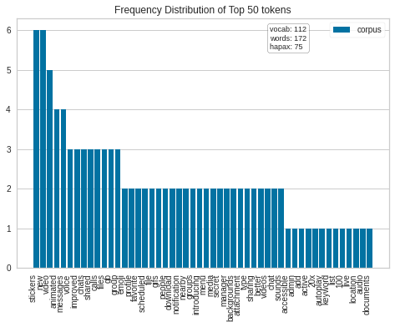
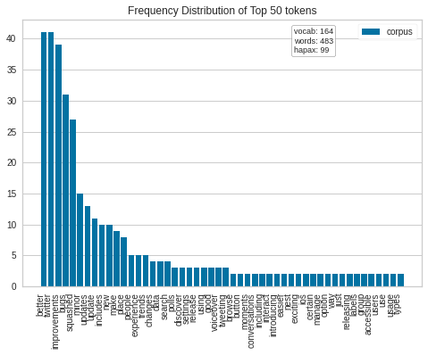
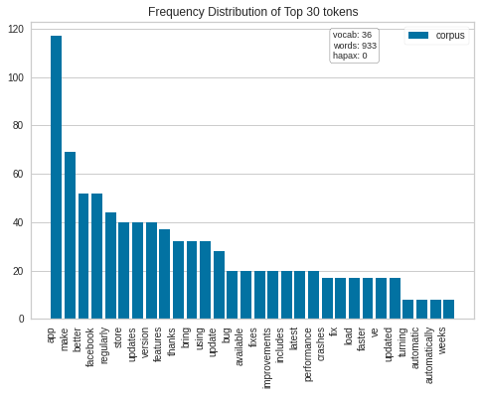



Plots for Social Media Apps
Telegram
Twitter
Facebook

Slide 14
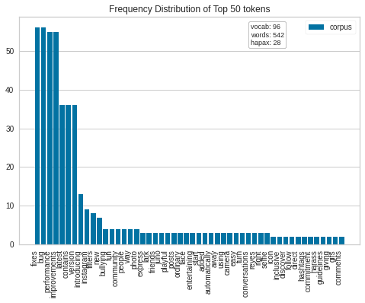
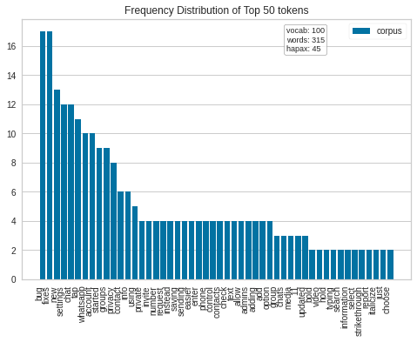


Contd.
Instagram
Whatsapp

Slide 15
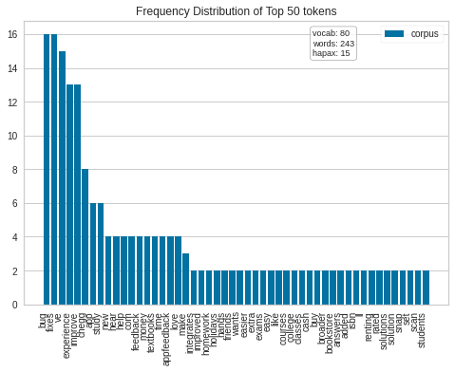
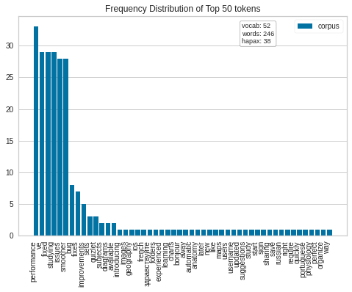
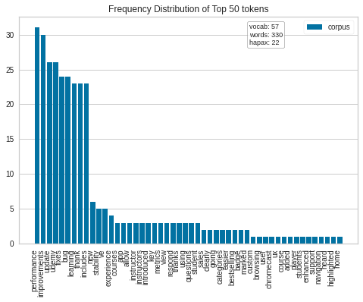
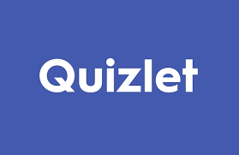


Plots for Educational Apps
Chegg
Quizlet
Udemy

Slide 16
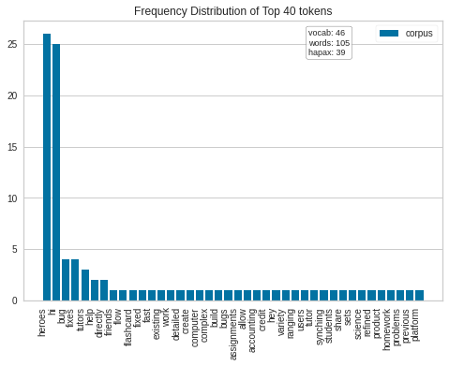
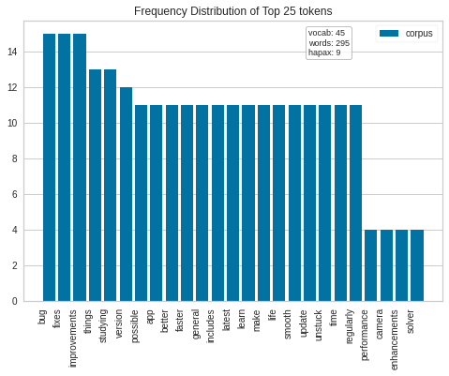


Contd.
Course hero
Photomath

Slide 17
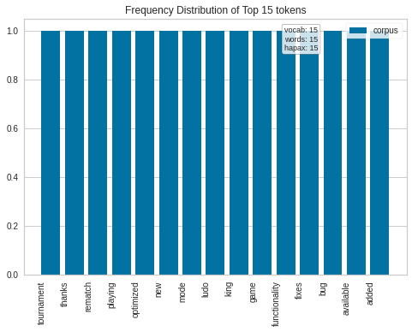
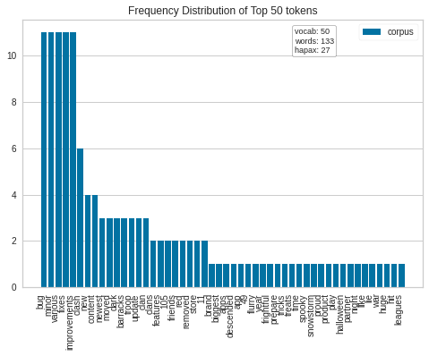
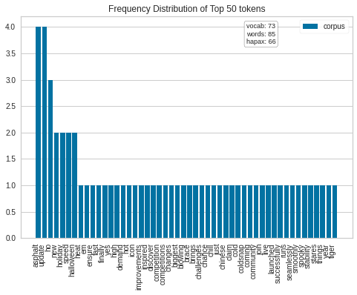



Plots for Gaming Apps
Ludo King
Clash of Clans
Asphalt 8 Airborne

Slide 18
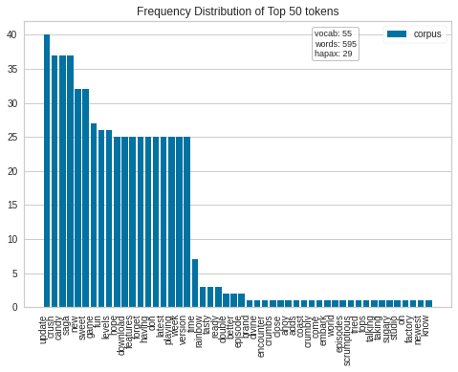
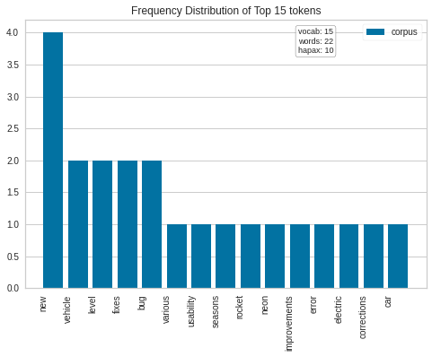


Contd.
Candy Crush Saga
Hill Climb Racing

Slide 19
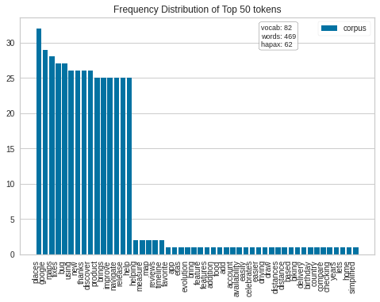
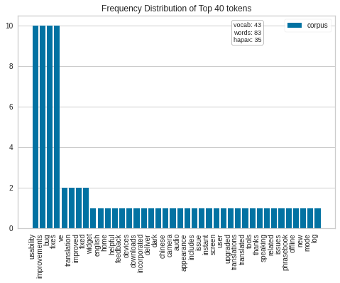
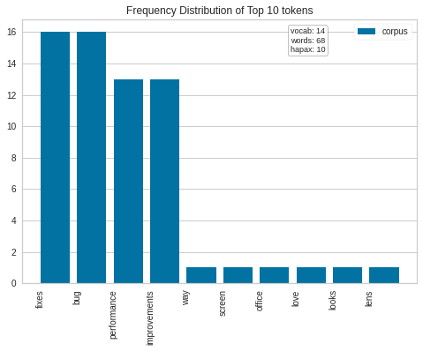



Plots for Utility Apps
Google Maps
Google Translate
Microsoft Lens

Slide 20
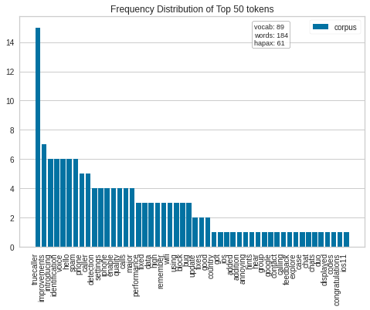
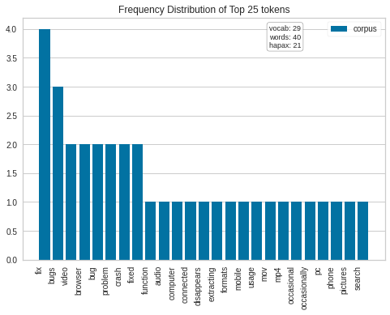


Contd.
Truecaller
Xender

Slide 21
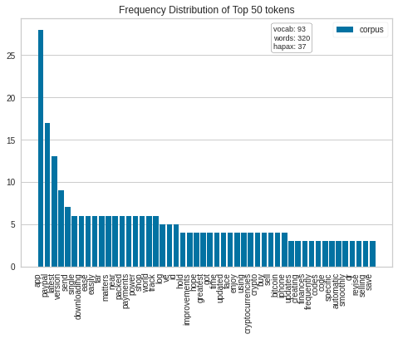
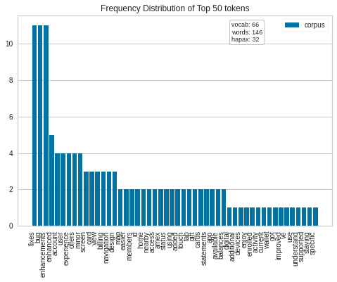
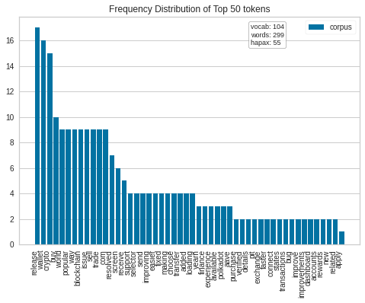



Plots for Finance/Banking Apps
PayPal
Amex
Blockchain.com wallet

Slide 22
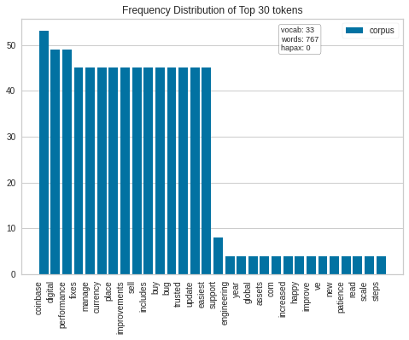
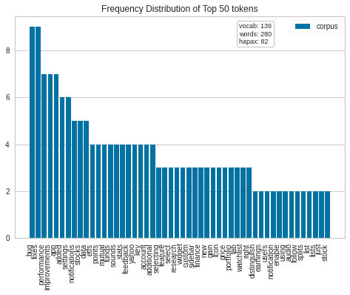


Contd.
Coinbase
Yahoo finance

Slide 23
Insights
S.No. | Category of App | Insights/Observations from bug fix statements
1 | Social Media | File sharing limit increased, Improved streaming support, Video Calls improvement, Many of them were UI/UX changes or addition of new features, Fix crashes, Make features load faster, Performance improvements.
2 | Educational | New features, Minor bug fixes, Problem in photo search resolved, Performance issues, Bug in automatic username suggestion, Stability improvements, User experience improvements, Chromecast support, Minor UX bugs resolved, Video player improved, Fixed common occurring crashes, Camera/Solver bug fixes.

Slide 24
3 | Gaming | Rematch functionality, Game optimization, Various bug fixes, error corrections, Usability improvements.
4 | Utility | Bug fixes, Improve compare ETAs across driving, transit, etc., Usability improvements, Performance Improvements, Fixed country code bug on the login page, Fix bug that the browser disappears occasionally, Fix the problem in transfer files from PC to mobile, Fix search crash problems, Solve crash bug during browser usage.
5 | Finance/Banking | Bug fixes, Minor enhancements, Fix digital receipts feature, the addition of more features, bug issue fix related to deposit details not shown, bug issue fix related to the balance not shown on the dashboard, bug fix to make a faster login to the wallet, fix notification bug.

Slide 25
Conclusion
From this study, with the help of the data analyzed and the insights, the effect of bugs on the developers can be resolved. It can be concluded that bug fixing and writing the proper code plays a vital role in the software development as well as software management. The insights provided are though less but still can be fruitful for the new developers. Also, the script can be used by the developers to get insights if any new bug fixes comes in any of the category.

Slide 26


Link to Code & GitHub Repository
Code Link: https://colab.research.google.com/drive/13GQ4_hyVDV9uVnRsqrIb_ydrBt6HaUBc?usp=sharing
Repo Link: https://github.com/Dev-Goel/Android-Play-Store-Data-Analysis

Slide 27
Acknowledgement
I would like to express my very great appreciation to my design credits project mentor Dr Sumit Kalra for his valuable and constructive suggestions, assistance with the methodology during the meetings I did with him in order to plan and execute the work required to be done and how it is to be done. His willingness to give his time so generously has been very much appreciated. I learned a lot through this project as I was introduced to many new things like web crawlers, web scraping, new python libraries, metadata of apps etc. I have put in a lot of effort in doing this project individually and had an overall good experience.

Slide 28
References
https://www.crummy.com/software/BeautifulSoup/bs4/doc/
https://www.zrix.com/blog/common-bugs-found-while-mobile-testing
https://www.softwaretestinghelp.com/why-does-software-have-bugs

Slide 29


